Slide 1
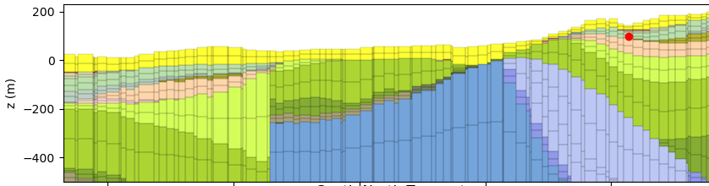





LoopFlopy : A workflow to bridge geological and groundwater flow models
Kerry Bardot
Co-authors: L. Grose^{b}, I. Camargoª, G. Pirotª, A. Siade^{a,c}, J.P. Pigois^{d}, C. Hampton^{e}, J. McCallumª
ª University of Western Australia, ^{b} Monash University, ^{c} CSIRO Australia, ^{d} Department of Water and Environmental Regulation, ^{e} Water Corporation, ^{f} Delft University
This is part of the Faults and Barrier study and financially supported by the Australian Research Council, Department of Water and Environmental Regulation of Western Australia, Water Corporation of Western Australia and Rio Tinto Iron Ore through Grant Number LP180101153.

Slide 2

What I’ll be presenting
Geological structures and groundwater flow
What is a groundwater model?
Problems with geo-flow modelling related to structure
What is LoopFlopy?
Examples of how the workflow can help groundwater modellers

Slide 3
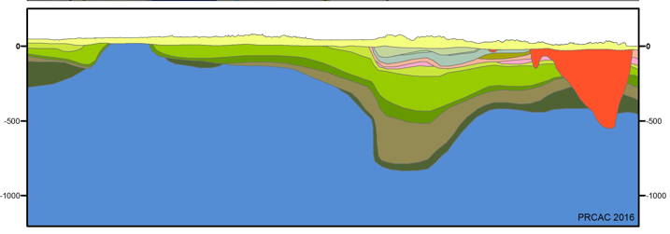
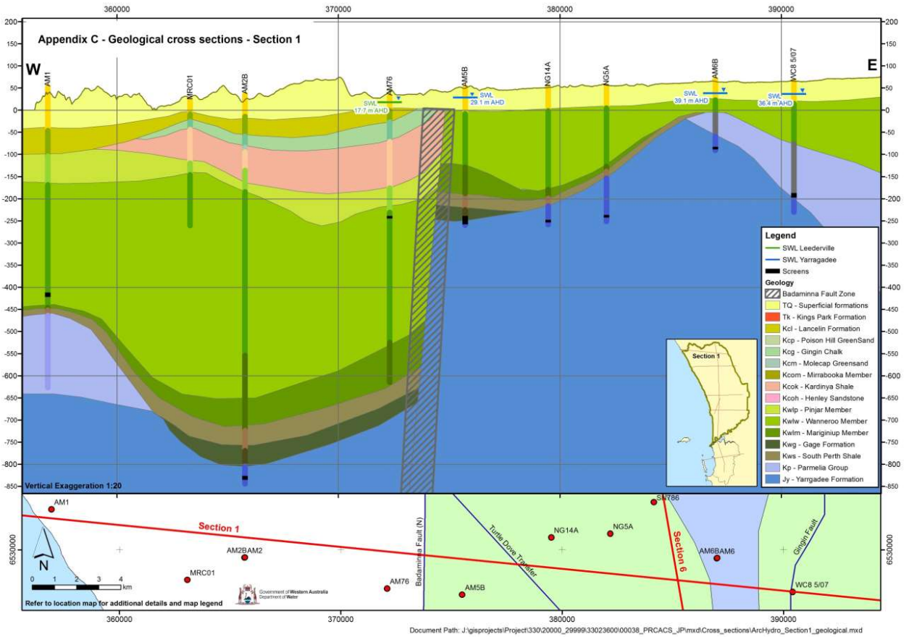
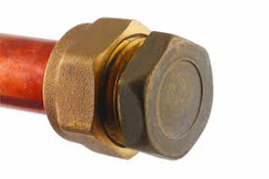
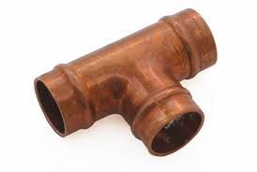
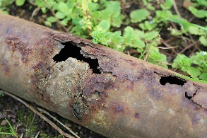
How important is structure for groundwater flow? VERY!
Aquifer 1
Aquiclude
Aquitard
Aquifer 1
Aquifer 2
Aquifer 2
Aquifer 2
Intrusion
Pinchouts
Faults

Slide 4

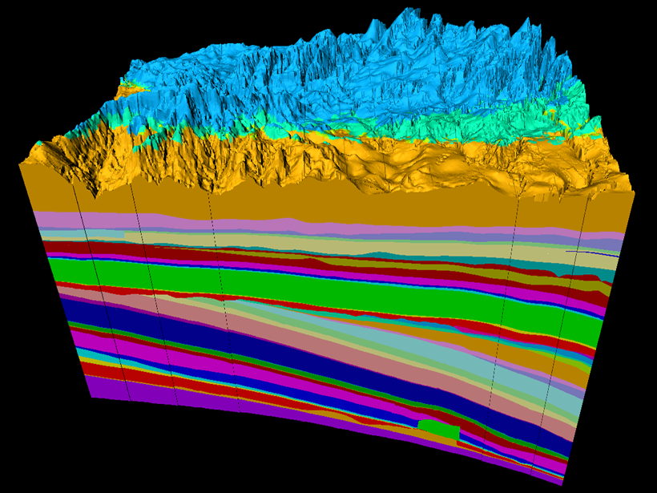
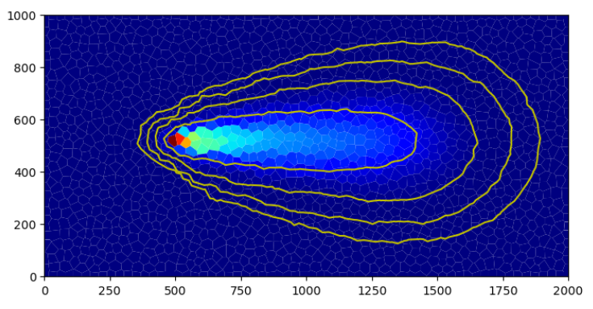

Groundwater modelling
Groundwater model =
Geological Model + Flow Model
CLUNKY!

Slide 5

Difference between Groundwater modellers and Reservoir modellers = $$$
Reservoir model =
Geological Model + Flow Model

Slide 6
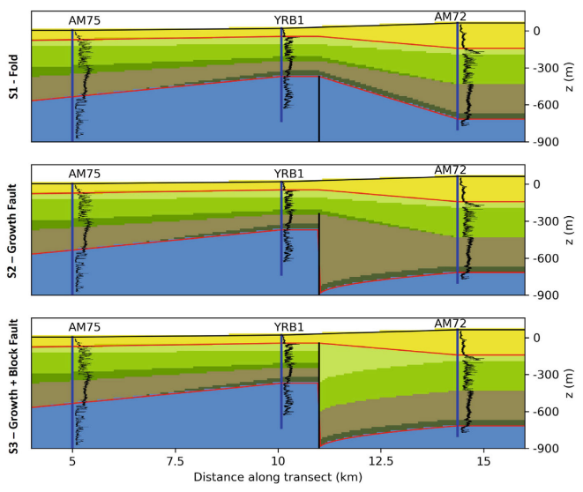
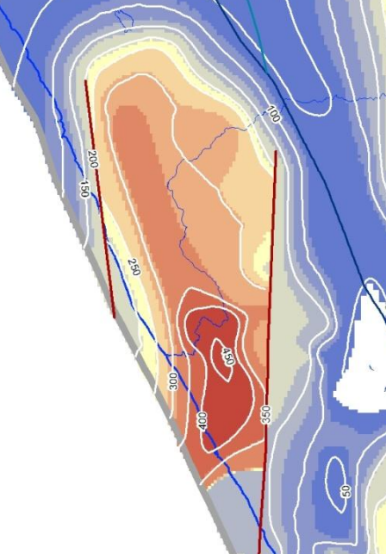
MAJOR Problems for groundwater managers/modellers… (besides money!)
Structural model A
Structural model B
Structural model C
Geomodelling software often gives “best guess” – rather than using probabilistic methods
A competing structural model =
another flow model =
a lot of time and energy = messy!

Slide 7
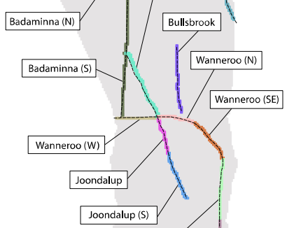
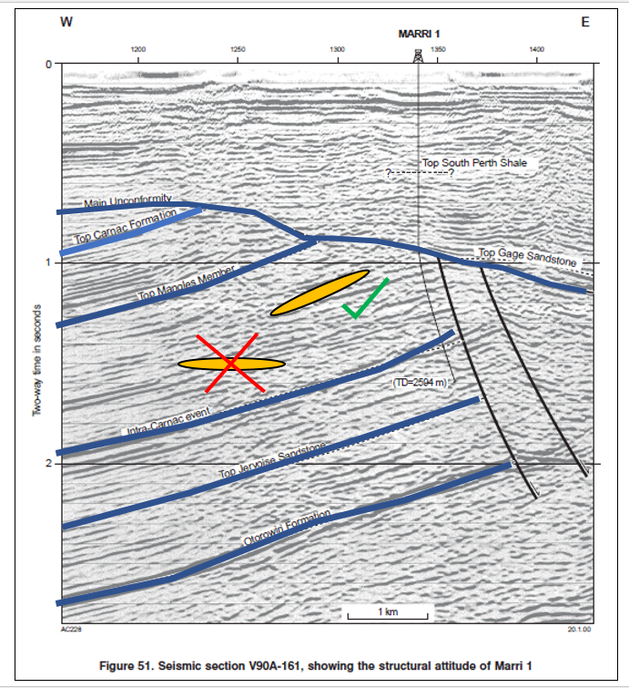

OTHER Problems for groundwater managers/modellers…
Kmax
Kmin
Hard to represent faults in current geo modelling software and flow modelling software
A dipping conductivity tensor is important for modelling flow –
but not often used.

Slide 8
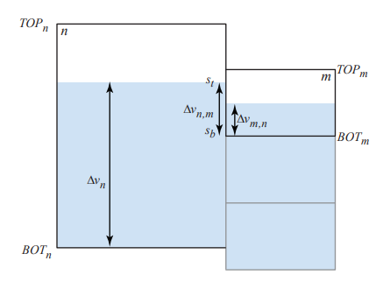
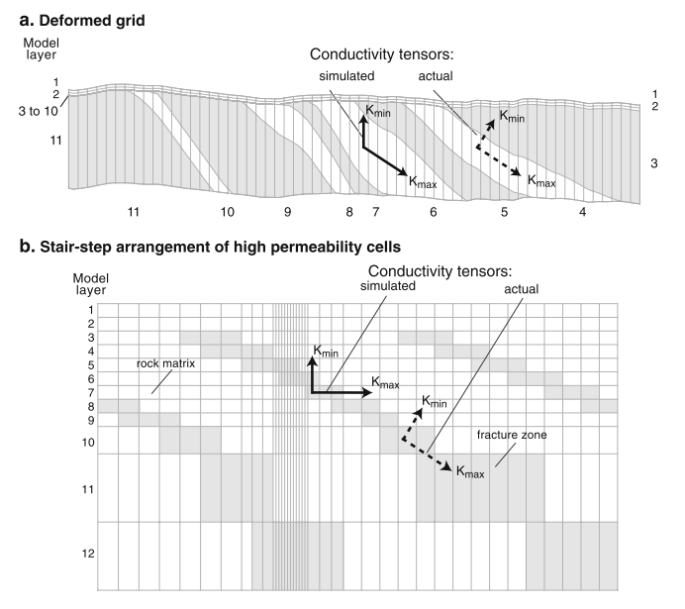
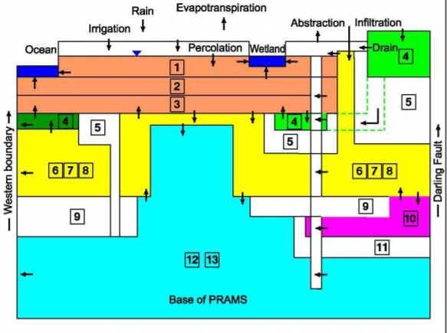
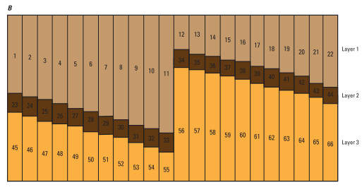
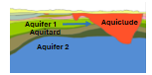
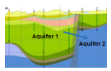
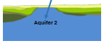
OTHER Problems for groundwater managers/modellers…
Meshing in Section: Popular flow modelling code MODFLOW has traditionally used “layer approach” – hard to represent complex structures
Dipping layers – yuck!
Intrusions and pinchouts – ew!
Faults – make it stop!

Slide 9
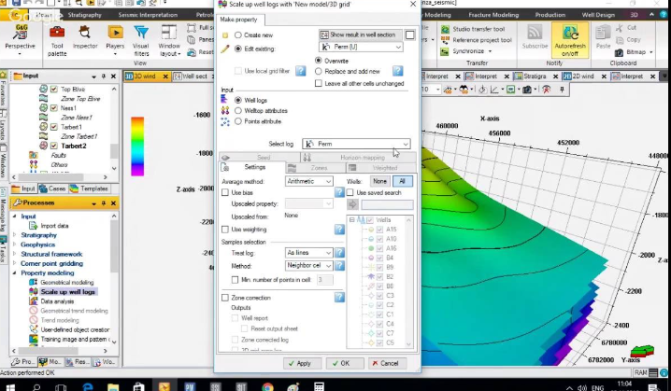
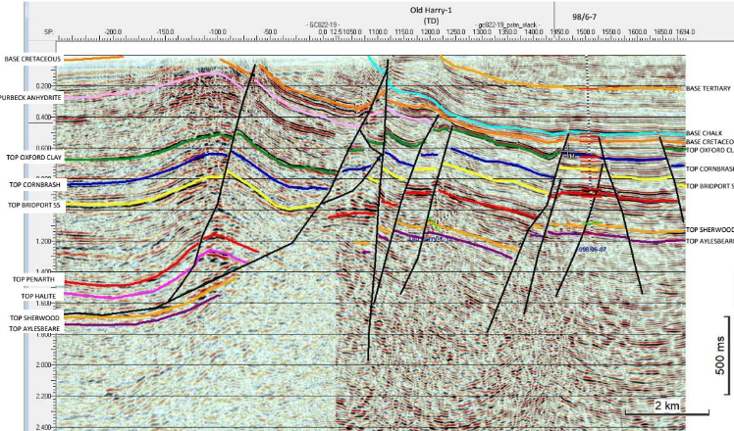
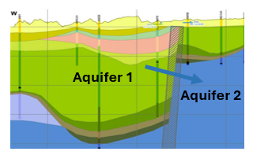
Therefore…
Because groundwater modellers have limited access to
fancy software used by the Petroleum Industry…
Because we don’t usually have as much data…(high uncertainty!)
Because we encounter complex structures that are critical for groundwater flow…
…we need accessible software that is sophisticated and can help address geological uncertainty and therefore uncertainty in groundwater predictions.

Slide 10


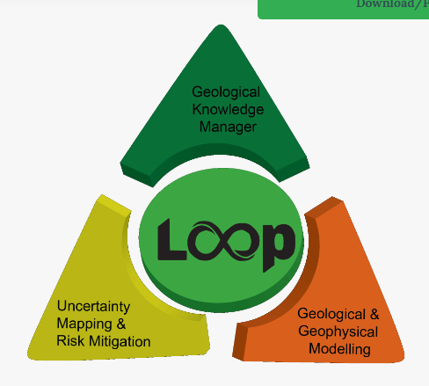
We’ve combined two AMAZING open-source packages – genius!
Groundwater model =
Geological Model + Flow Model
GEO MODELLING
Loop Structural
FLOW MODELLING
MODFLOW 6 (Flopy)

Slide 11
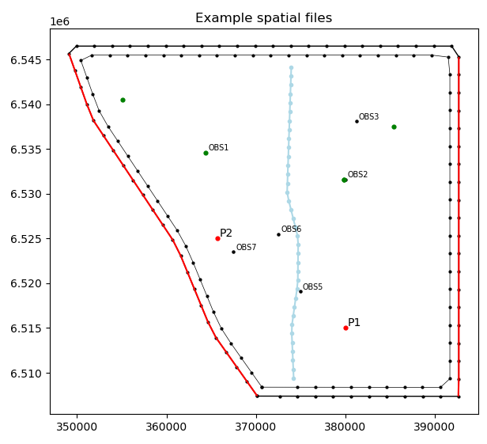

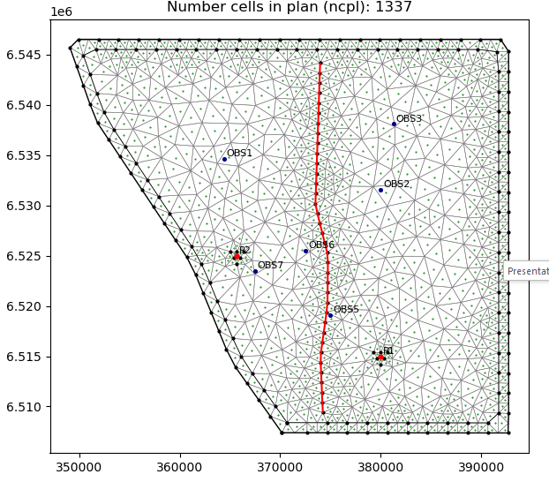
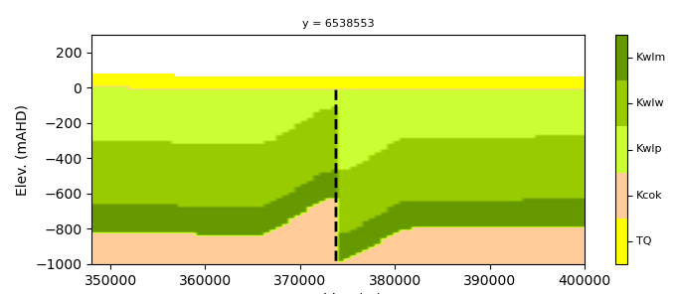
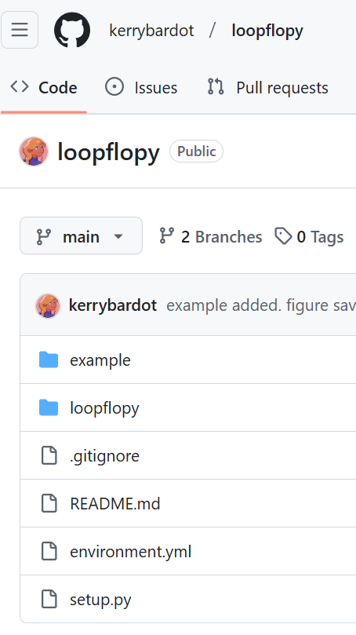
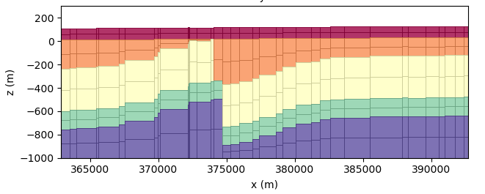
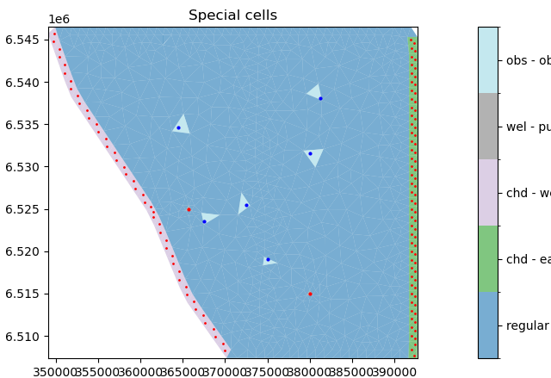
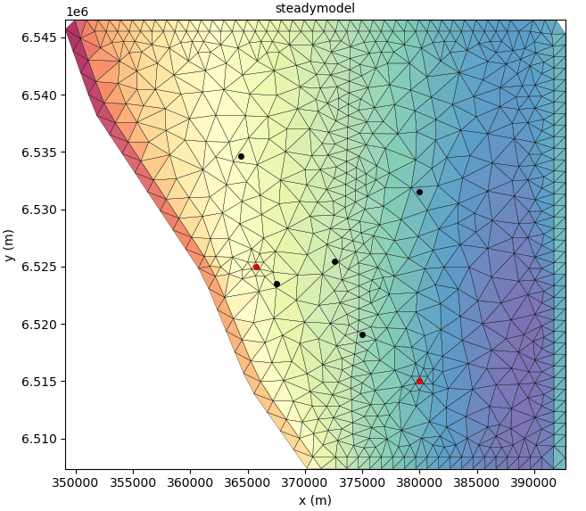
What does
LoopFlopy
look like…
1. SPATIAL
Class for processing spatial files (Geopandas)
2. STRUCTURAL MODEL
Simple structural model example using LOOP
3. MESH
Class for meshing including refinement options
4. GEOMODEL
Converts mesh + structural model into lithology block model
UTILS Modules for handling unstructured MODFLOW grids (cell IDs, plotting…)
5. FLOWMODEL Modules for handling unstructured MODFLOW grids (cell IDs, plotting…)

Slide 12
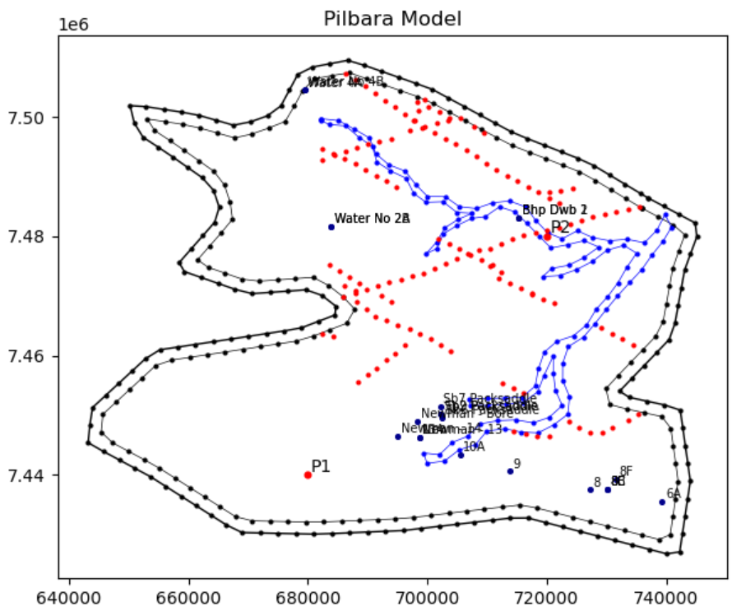
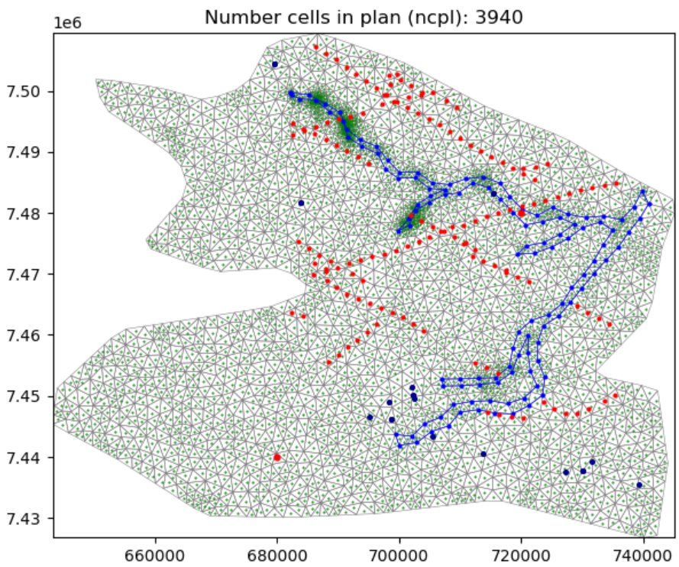
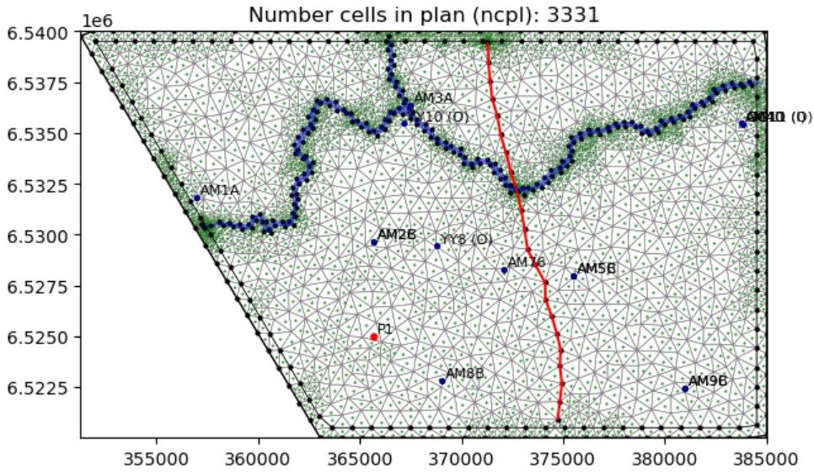
Flow modellers get a bit fussy about meshing so we like to make our own…

Slide 13
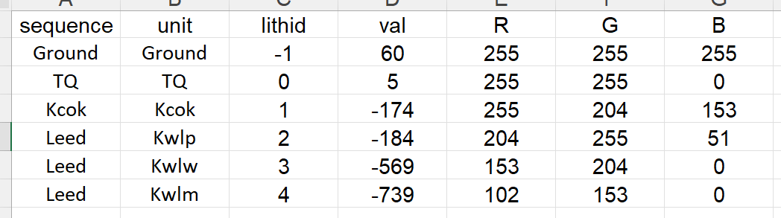
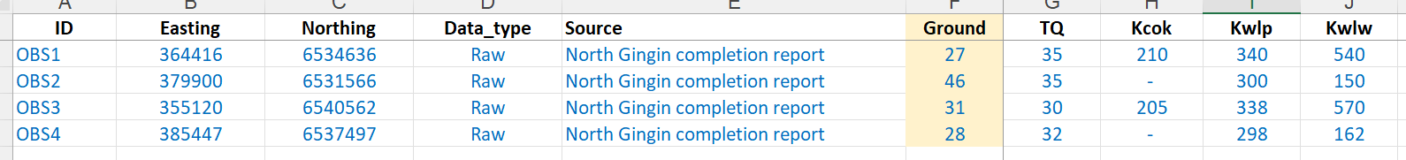
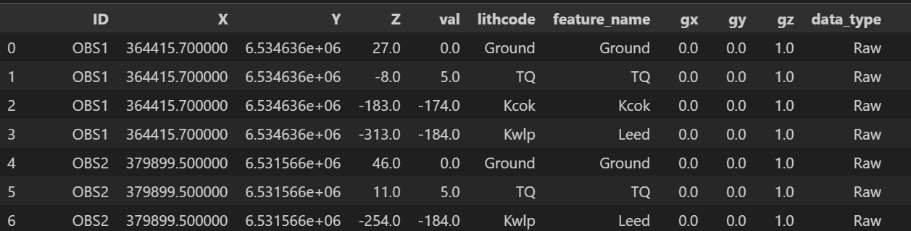
Strat column created using excel
Missing units can be a challenge!
Boreholes converted to Pandas dataframe to be “Loop Ready”
mAHD
Depth to bottom of unit

Slide 14
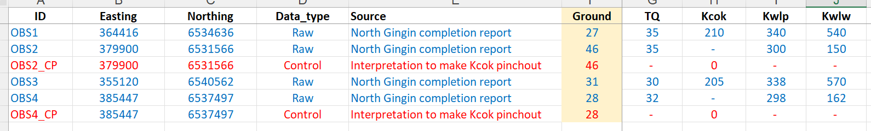
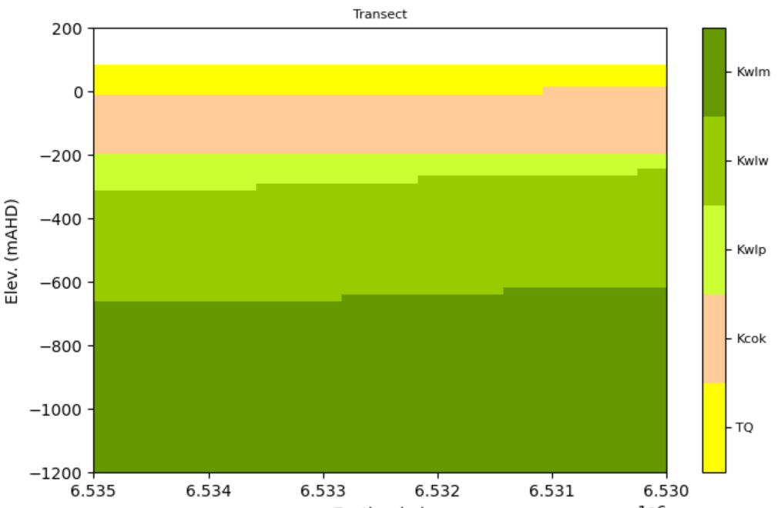
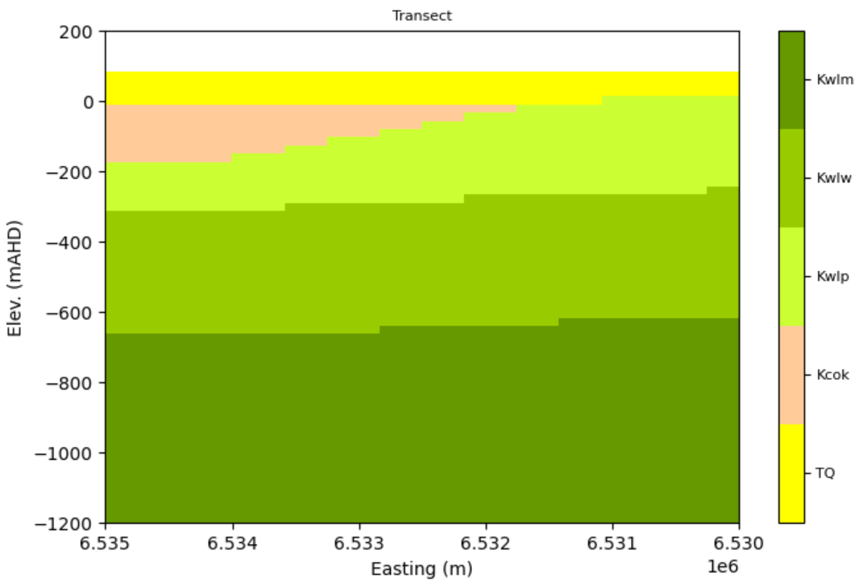
I put “control points” in my data spreadsheet and document justification (and make clear RAW vs CONTROL)
Then, you can make multiple models easily by changing the control points.

Slide 15
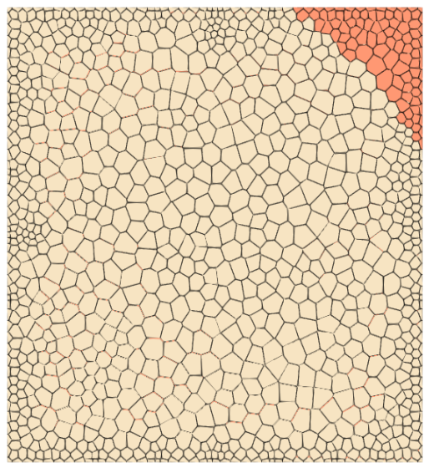
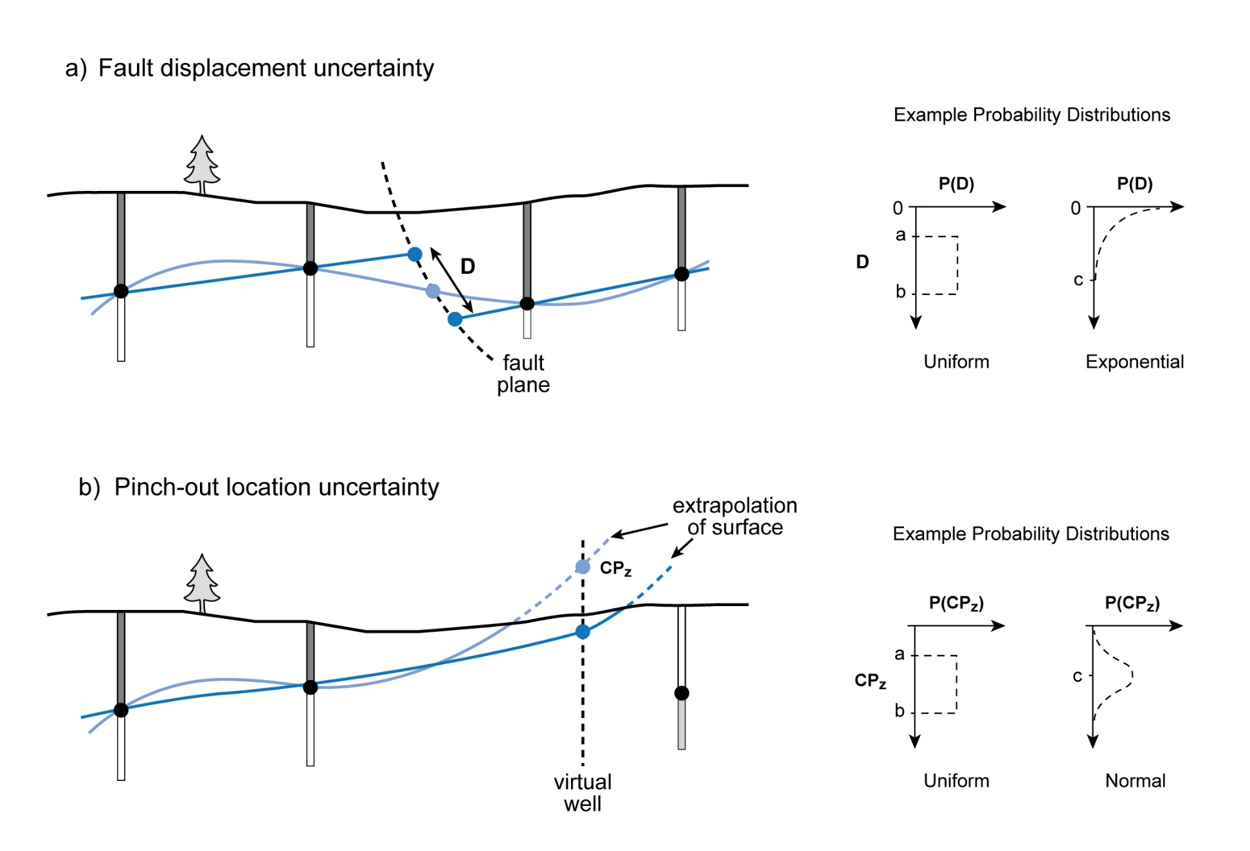
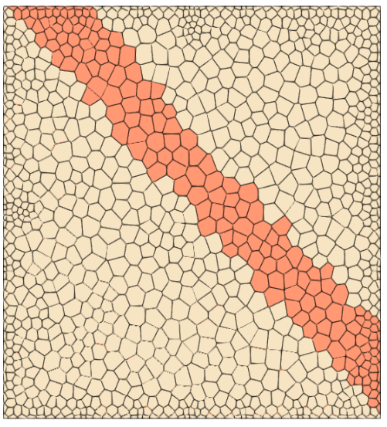
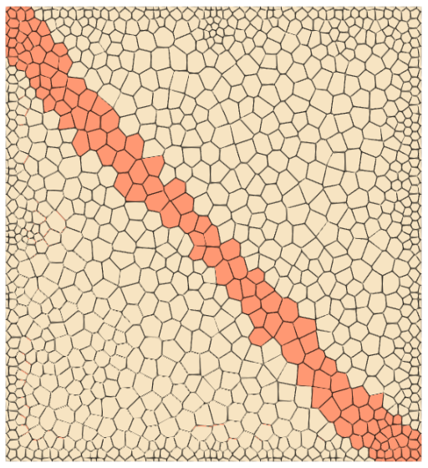

LoopFlopy Advantage #1
Addresses structural uncertainty using a
multi-model approach
Geomodelling software gives “best guess” – rather than using probabilistic methods
We can do
probabilistic structural modelling with LoopStructural using structural parameters

Slide 16
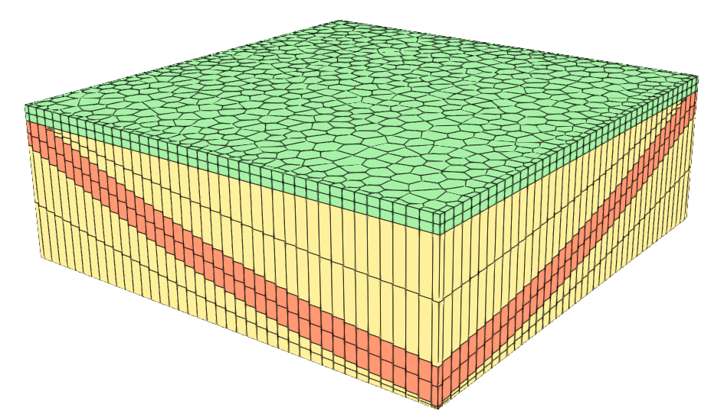

LoopFlopy Advantage #2
Flow model updates with new interpretation or geological data
A competing structural model
= another flow model
= a lot of time and energy!
By linking the geo and flow model together, new flow model “conjured up” when structural model changes

Slide 17

LoopFlopy Advantage #2
Flow model updates with new interpretation or geological data
Can help explore structural uncertainty

Slide 18





LoopFlopy Advantage #3
Can find areas sensitive to structural uncertainty
Can help quantify uncertainty and guide further data collection
-250 < CPz < 0
0 < D < 200 m
Standard deviation in hydraulic head (100 realisations)

Slide 19
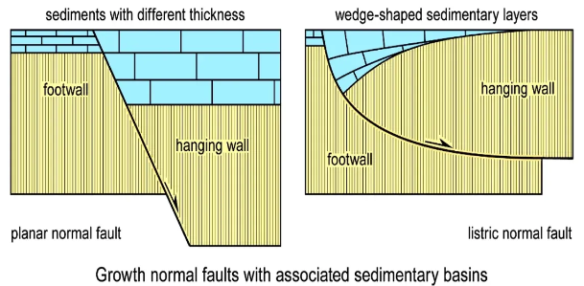
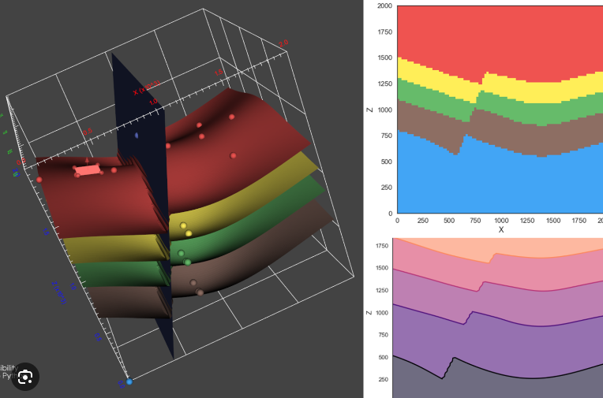
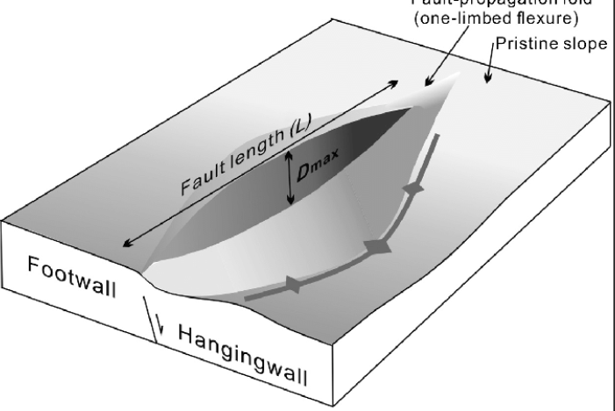
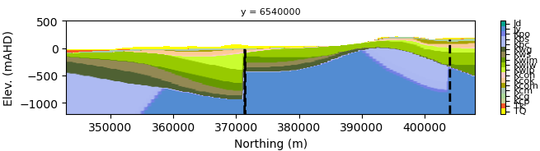
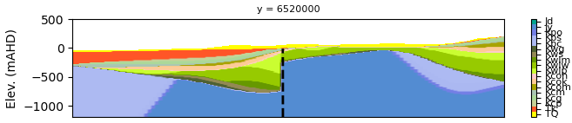
LoopFlopy Advantage #4
Can model complex geology (faults/folds)
Parameters to handle complex fault geometries.

Slide 20
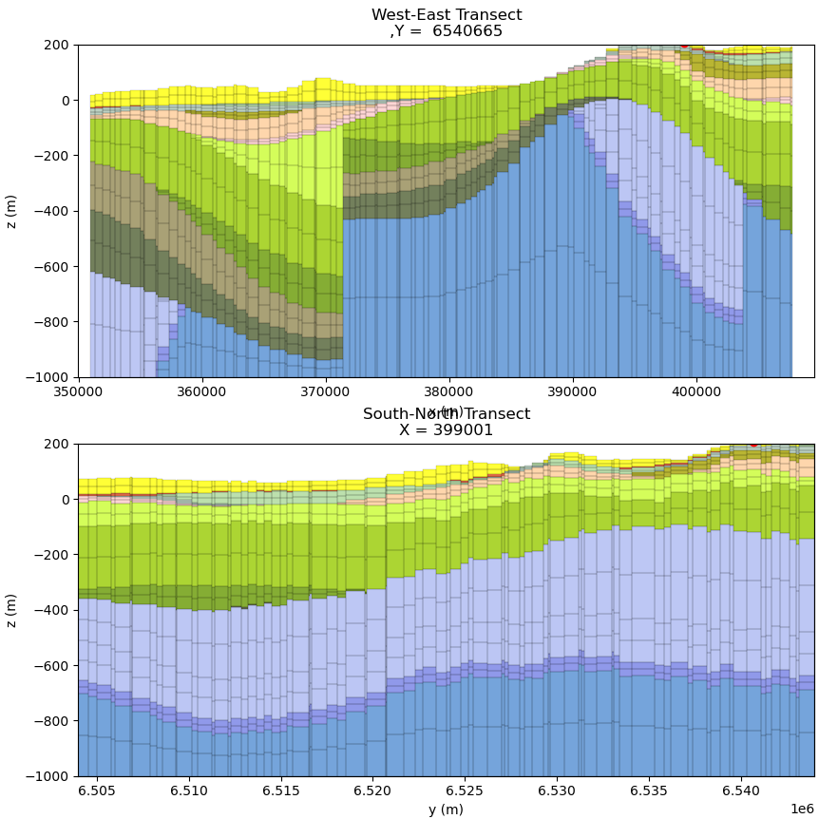

LoopFlopy Advantage #5
Unstructured grid adapts to structural model
Intrusions, pinchouts and faults hard using a “layered approach”…
We can more easily model intrusions, pinchouts and faults with unstructured grids with MODFLOW 6
We have a method using a full-connectivity grid!

Slide 21

LoopFlopy Advantage #6
Generates dip angle so we can use full K tensor
Kmax
Kmin

Slide 22

LoopFlopy Advantage #7
Open-source!

Slide 23

Where it’s at…

Slide 24


Currently just doing some experimenting using a Perth Basin Submodel

Slide 25


Structural Model
An implicit model created by LoopStructural of stratigraphic and fault surfaces
Inputs: Drilling data, topography, stratigraphic sequence (order), typical thickness of units, surface orientations, fault parameters (orientation, ellipse geometry), seismic

Slide 26



Additional data from Seismic
Well Ties
Unconformity
Shale
Displacement
Faults
Depth Correction
Masters project to look at incorporating seismic into the structural model

Slide 27



Control points – Uncertainty West of Badaminna Fault
Structural control points
Fault Displacement
D?
Control point
Bore not deep enough!
Control point
D?

Slide 28

Identifying cells
Cells identified based on xyz – NOT lay, row, col (gets messy when you use unstructured grids, but we’ve got you sorted)

Slide 29

Geomodel
Structural model turned into a cell-based model with cells assigned hydrogeological properties
Inputs: Structural model, Mesh, grid type in transect (regular or conformable layers), number of sublayers

Slide 30

Flow model
Geological model turned into a MODFLOW 6 model using unstructured grids in plan and section

Slide 31

To wrap up…
Structure controls groundwater flow
We have combined LoopStructural with MODFLOW (Flopy)
There are many useful advantages of the workflow
Opens doors to a lot of further research about structural uncertainty
Now to develop it further and apply to real sites!
Please come chat to me to find out more!

Slide 32





Structural Model
Geo (block) Model

Slide 33



Slide 34



Slide 35




Slide 36



Structured
Voronoi
Triangular

Slide 37



Triangular
Voronoi
Structured

